Slide 1
Updates
Michelle Nienhius, MPH
Manager, Division of Prevention and Intervention Services
May 6, 2021
Notes:
Custom DAODAS color codes is : Red-0
Green-131
Blue-139

Slide 2
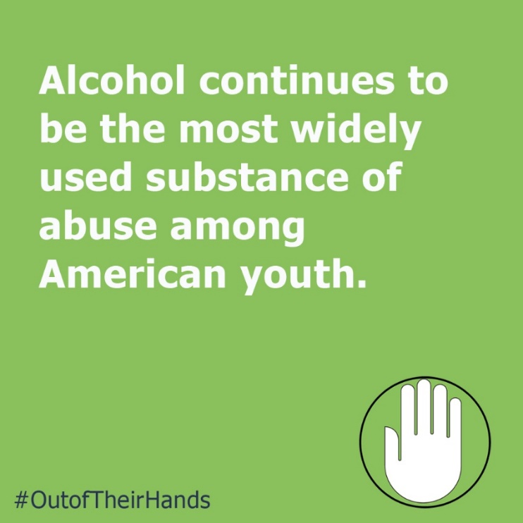
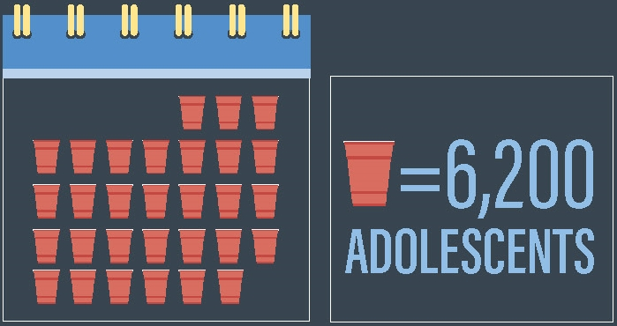
Out of Their Hands Campaign Continues….
https://www.daodas.sc.gov/prevention/law-enforcement/underage-drinking/hands-social-media-graphics/
AET Coordinator’s Meeting- May 25th 10 am-noon or 1:30-3:30 pm via ZOOM- contact Cecily if you need information on how to join.

Slide 3
Synar Study for regions 1 and 4 ends May 14th (unless you have received an extension)
Paperwork is due to DAODAS June 1st
Contact Cecily Watkins if you have any questions (cwatkins@daodas.sc.gov)
This Photo by Unknown Author is licensed under CC BY-SA-NC

Slide 4
PREP Reminders
Some county agencies are implementing PREP via ZOOM, Adobe Connect, or some other online platform. Please notify Michelle Nienhius via email if you are (or plan to) teach PREP virtually.
While face-to-face delivery of the program is still the preferred method, it is understandable that during the public health crisis, this program will need to be delivered via technology. Fidelity of the program and delivery of all material continues to be of utmost importance. The virtual platform that you choose should allow you to:
Utilize all program materials- power point, handouts and videos
Have a discussion with participants and answer questions
Your agency may need to mail the participant booklet ahead of the class (or if your offices are still open, have participants come by to pick-up materials prior to the class). Using a platform that allows you to see your participants is best-this will allow you to interact with (see when they have a question, looking confused, etc.).

Slide 5
PREP Reminders
Test Link: https://www.classroomclipboard.com/830067/Test/C3C50C36-48CC-4FE8-9343-B1A289F34409
The test can be taken online using link above and code (FEFAHFF). The participant has 30 minutes to complete the test. The test is saved in the DAODAS account.
At the conclusion of the course, please send the following information for us to email you the scores and test results back:
first and last name of the participant (we need to know the exact name they register with to take the test) and the date of the training.
Email that information to: DAODAS - STEP Program email: daodas.stepprogram@daodas.sc.gov
All paperwork will also need to be submitted to DAODAS for certification cards to be mailed out. Certification cards will not be sent out right away as we are working remotely and not in the office at this time. Please provide the participant with a letter indicating they successfully completed the course if they need proof of certification/completion until the card is processed.

Slide 6
End of Fiscal Year Reminders
Year-end benchmarks shall be entered into the MOSAIX IMPACT system for all process and outcome objectives no later than the eighth working day of July; and
All prevention programs using the DAODAS Standard Survey that are administered January-May are required to submit their data to DAODAS by the published date in June.
This Photo by Unknown Author is licensed under CC BY-NC

Slide 7
BHSA Updates
SAPST Reminder:
SAPST will be held June 21-24 at The National Safety Council. Registration information can be found on BHSA's website. Class size is limited, and registration will close when we reach capacity.

Slide 8
SCAPPA Updates
The spring training will be held virtually on June 17th. The topic will be on Opioids and the trainer will be Master Deputy David Kopenhaver. Registration will be $15. More information coming soon.
Certification Update:
As of February 1, 2021, we have an updated manual for the field. Those of you who are certified and/or in process are encouraged to download or utilize the on-line updated version. You can find the newest version in the Certification Section on the SCAPPA website. The individual forms on the website also reflect the updates and changes. In addition, sample Certification, Recertification and Upgrade applications have been provided.
As of the July 2021 Recertification cycle, a requirement for an additional 3 hours of Ethics Training, will take effect. This has been listed in the updated manual, and is marked as a requirement for those who recertify in July 2021 and all cycles to follow. It is also a requirement to read and sign the updated Ethics Document each time you recertify. A 3-hour training that met this requirement was provided by our BHSA coaches on May 3rd.

Slide 9
National Prevention Week (NPW) is a public education platform that promotes prevention year-round through providing ideas, capacity building, tools, and resources to help individuals and communities make substance use prevention happen every day.
Each year, National Prevention Week includes daily themes to focus on major substance use and mental health topics. The 2021 daily themes are:
Monday, May 10: Preventing Prescription Drug and Opioid Misuse
Tuesday, May 11: Preventing Underage Drinking and Alcohol Misuse
Wednesday, May 12: Preventing Illicit Drug Use and Youth Marijuana Use
Thursday, May 13: Preventing Youth Tobacco Use (E-Cigarettes and Vaping)
Friday, May 14: Preventing Suicide
https://www.samhsa.gov/prevention-week

Slide 10
Planning stipends are now available for Communities Talk, a biannual activity SAMHSA sponsors to mobilize communities to prevent underage drinking!
SAMHSA provides a limited number of $750 planning stipends on a first-come, first-served basis to community- and state-based organizations interested in promoting underage drinking prevention. Click here to request an invitation to register, and then copy and paste this message into the body of the email: “I’d like to request a $750 planning stipend to participate in Communities Talk. Please send me a unique URL to begin my registration.”
Please note that invitations will be sent on a rolling basis.
The Communities Talk Quick Start Planning Guide helps you quickly and easily learn how to host a results-oriented activity in your community. The guide contains a planning calendar, a planning checklist, detailed steps to help you plan an activity and share your work, and frequently asked questions about Communities Talk.

Slide 11
******June 23, 2021*****
Please register for South Carolina - Marijuana, Delta 8, CBD, Vapes and More!
1.5 hours on Jun 23, 2021 11:00 AM EDT at:
https://attendee.gotowebinar.com/register/3399217577512348176
After registering, you will receive a confirmation email containing information about joining the webinar.
******August 20, 2021*****
Please register for South Carolina - Youth Transition to School / Effects of the Pandemic - Drug Trends! - 1.5 hours on Aug 20, 2021 1:30 PM EDT at:
https://attendee.gotowebinar.com/register/6979793686039663888
After registering, you will receive a confirmation email containing information about joining the webinar.

Slide 12
There is still time to register!
2021 NLLEA Training Symposium Registration
You can choose to attend one or more of the following webinars. Time shows in EST
Day 1 - May 11, 2021 12:45 pm Opening Remarks - 1-5 pm Workshops
Day 2 - May 18, 2021 12:45 pm Opening Remarks - 1-5 pm Workshops
Day 3 - May 25, 2021 12:45 pm Opening Remarks - 1-5 pm Workshops
https://us02web.zoom.us/webinar/register/WN_5ZAGZEobSq20A_zh46Aqyg
The 2021 Annual Conference, will be held November 15-17 in Montgomery, Alabama at the Renaissance Montgomery Hotel & Spa at the Convention Center,
in collaboration with the Alabama Law Enforcement Agency (ALEA) State Bureau of Investigation. Conference registration and hotel accommodations are now open!
https://nllea.org/Event/Registration?id=14

Slide 13
Calling all South Carolina Coalitions and Substance Use and Misuse Professionals! Every year, over 3,000 community substance use and misuse prevention coalitions and specialists gather at CADCA's Mid-Year Training Institute to further their mission of creating and maintaining safe, healthy and drug-free communities globally. As a valuable member of the NPN community, CADCA looks to you for support as we rally South Carolina's substance use and misuse prevention professionals to attend Mid-Year from July 11-15! Encourage your network to participate in 100+ specialized adult and youth training sessions and workshops, networking opportunities and wellness activities. Early Rates ends in one month on Monday, June 7. Show Your Support

Slide 14
Join us for the 34th Annual National Prevention Network Conference
Resilience in Prevention: Opportunities to Adapt and Build for a Stronger Tomorrow
August 24 - 26, 2021
REGISTRATION: https://npnconference.org/
Opens in early June
Early Bird Registration (on or before June 30): $300
Regular Registration (after June 30): $350

Slide 15
Alcohol Policy 19: Building a Framework for Change
Alcohol Policy 19/AP19 Conference
Apr 27, 2022, 2:00 PM
Renaissance Arlington Capital View Hotel
Register Now
The 19th in a series of conferences on preventing and reducing alcohol-related problems using public policy strategies.
​
The alcohol policy conferences are a series that, from its outset in 1981, has been a forum for researchers, community practitioners, and public officials to meet and exchange findings, explore evidence-based solutions, and consider adoption of policies aimed at minimizing risks associated with alcohol use. The conferences have been organized by governmental, non-governmental and private organizations over the years.

Slide 16
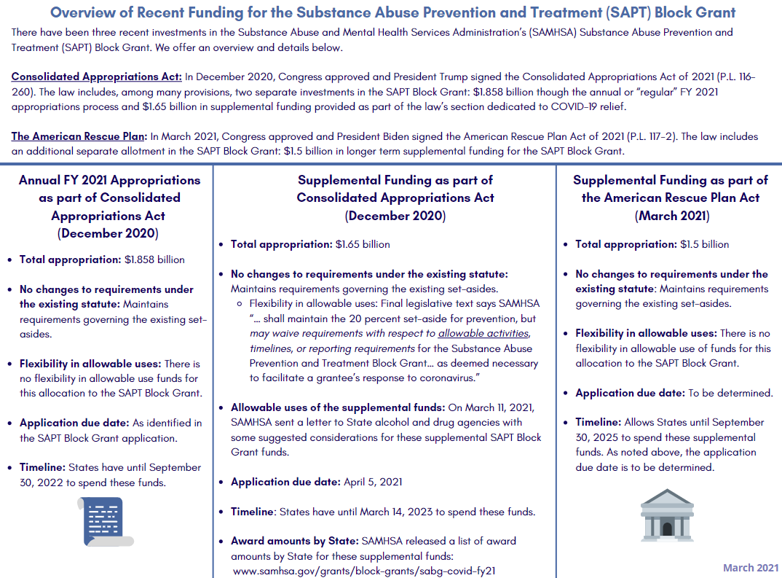
Information Reference: NASADAD

Slide 17
Consolidated Appropriations Act of 2021: CoVID-19 provisions
SAPT Block Grant: $1.65 billion
“… with respect to the amount appropriated under this heading in this Act the Substance Abuse and Mental Health Services Administration shall maintain the 20 percent set-aside for prevention, but may waive requirements with respect to allowable activities, timelines, or reporting requirements for the Substance Abuse Prevention and Treatment Block Grant and the Community Mental Health Services Block Grant as deemed necessary to facilitate a grantee’s response to coronavirus”
Community Mental Health Services Block Grant: $1.65 billion
Certified Community Behavioral Health Clinics: $600 million
Suicide prevention: $50 million
Project AWARE to support school-based mental health for children: $50 million
Emergency grants to States: $240 million
National Child Traumatic Stress Network: $10 million
At least $125 million of these SAMHSA funds must be allocated to tribes
Information Reference: NASADAD

Slide 18
Another COVID-19 Package
In January, President Biden released the American Rescue Plan
Proposed $4 billion for SUD/MH program within SAMHSA and HRSA
In March 2021, lawmakers passed, and the President signed, the American Rescue Plan into law:
$1.5 billion for SAPT Block Grant
Allows States until September 30th, 2025 to expend these resources
Does not include language on flexibility
Information Resource: NASADAD

Slide 19
Biden-Harris Administration Statement on Drug Policy Priorities (April 1, 2021)
Expanding access to evidence-based treatment
Advancing racial equity in our approach to drug policy
Enhancing evidence-based harm reduction efforts
Supporting evidence-based prevention efforts to reduce youth substance use
Reducing the supply of illicit substances
Advancing recovery-ready workplaces and expanding the addiction workforce
Expanding access to recovery support services
BidenHarris-Statement-of-Drug-Policy-Priorities-April-1.pdf (whitehouse.gov)
Information Resource: NASADAD

Slide 20
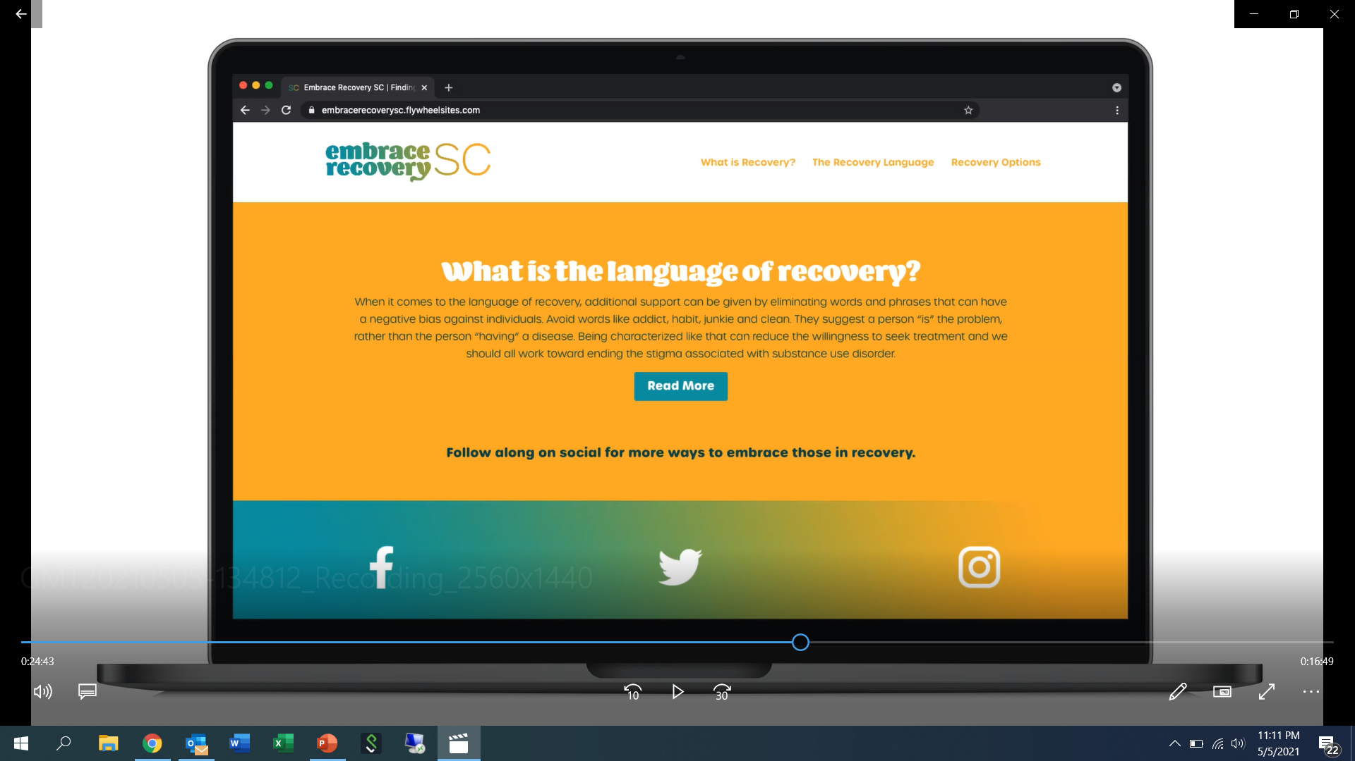
Embrace Recovery SC
Campaign Kick-off with Governor McMaster next week- May 13th
State House Grounds 11:30 am

Slide 21
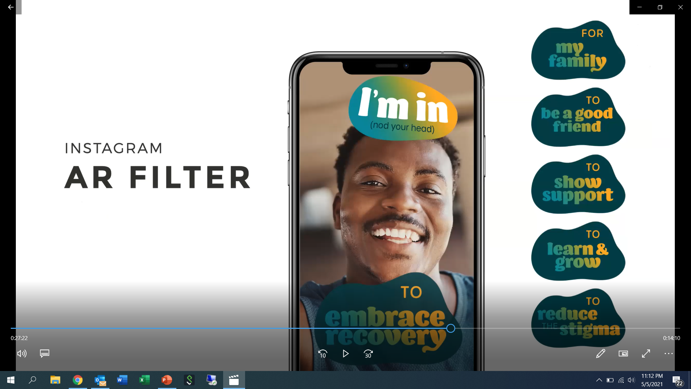
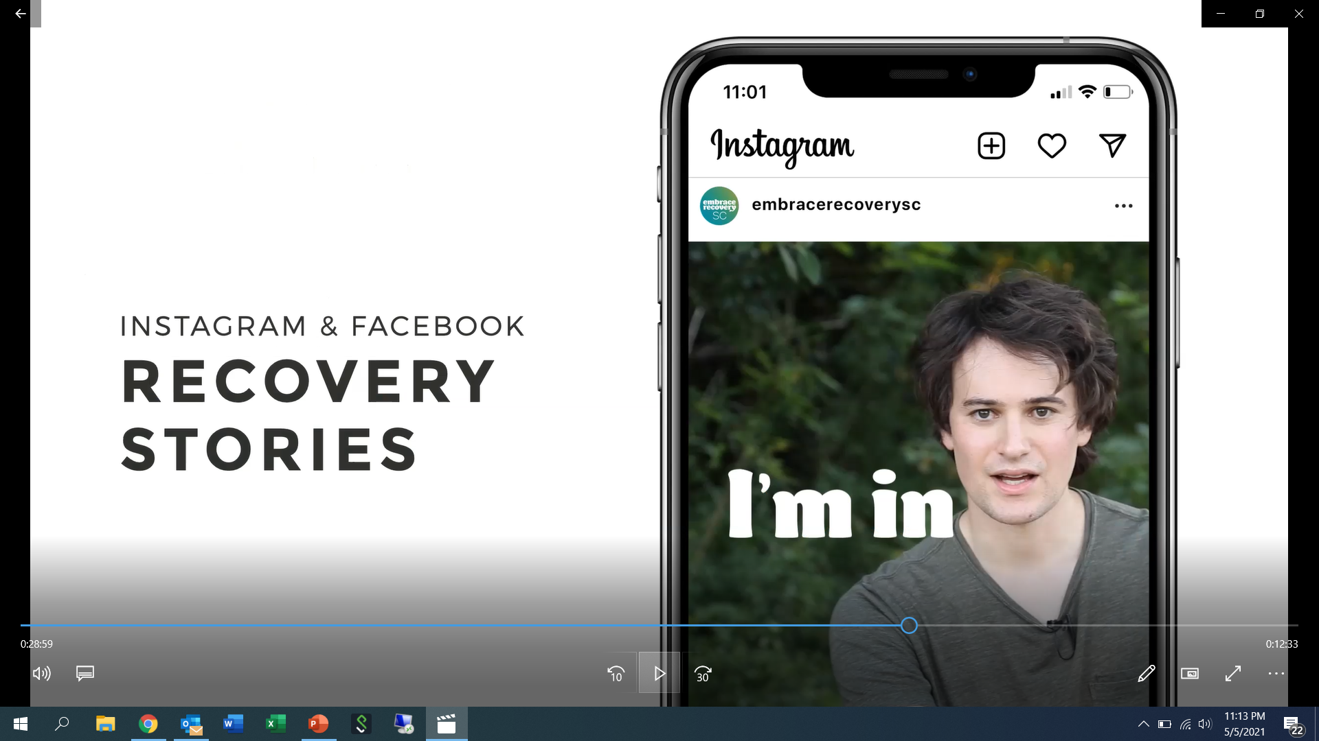
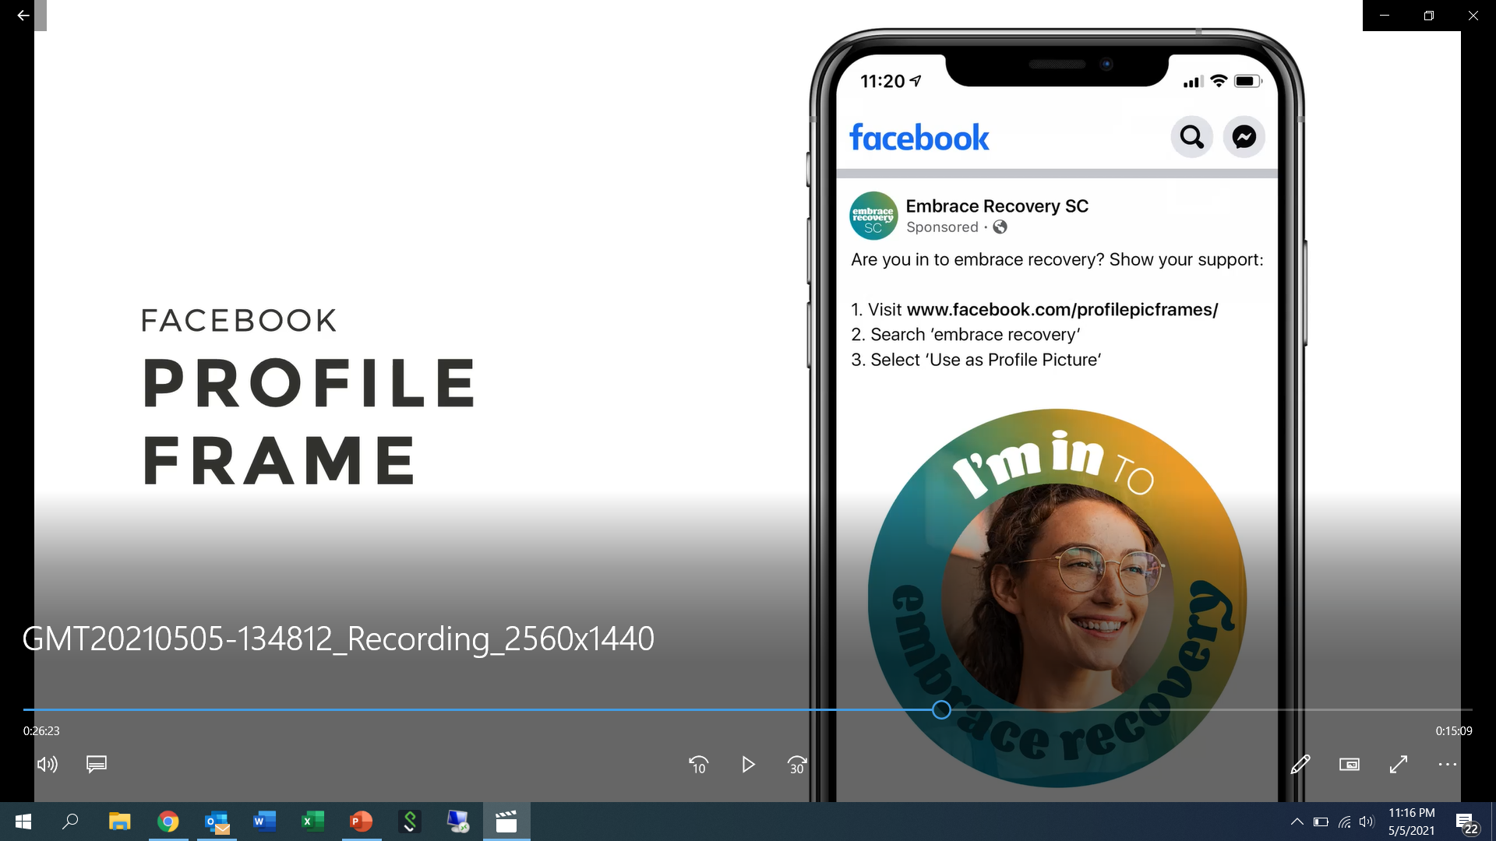

Slide 23
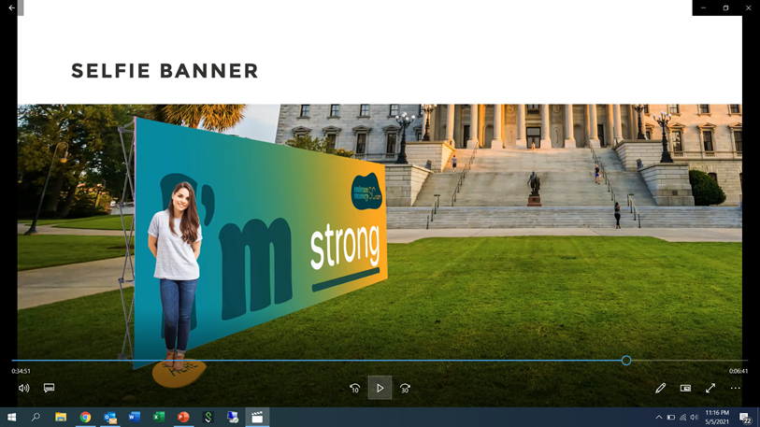

Slide 24
Just Plain Killers Radio and Streaming Campaign
Delivered Bonus Impressions: 20 Million
Analytics show that there is 31% in incremental website traffic on days that radio ads are
Total Value 1st Quarter Media Campaign:
Paid: $133,332.32
Bonus: $184,395.47
Total: 317,728.79

Slide 25
KELLY NASH Big Sue Kelly Golden
Aaron Michael Adam Dellinger

Slide 26
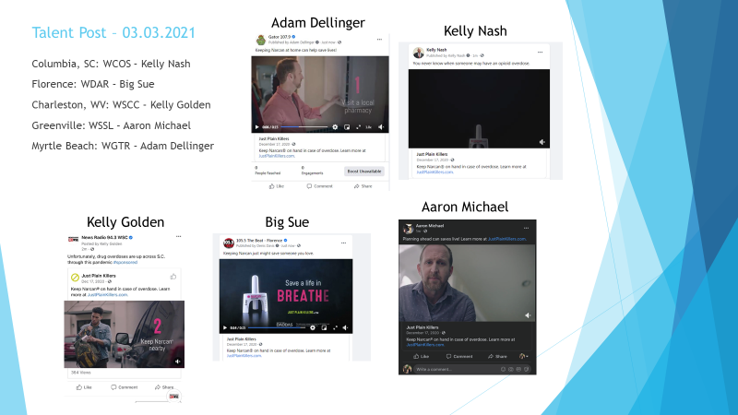

Slide 27
TTWN – Markets & Stations
Total Traffic & Weather Network
Charleston, SC | Columbia, SC | Florence, SC | Greenville-Spartanburg, SC | Myrtle Beach, SC
WEZL-FM | WCOS-FM | WBZF-FM | WESC-FM | WDAI-FM
WIWF-FM | WLTY-FM | WMXT-FM | WFBC-F2 | WGTR-FM
WMGL-FM | WLXC-FM | WYNN-FM | WFBC-FM | WLFF-FM
WFRQ-FM | WNKT-FM |  | WMYI-FM | WRXZ-FM
WSC-FM | WNOK-FM |  | WROO-FM | WSEA-FM
WSSX-FM | WOMG-FM |  | WROQ-FM | WSYN-FM
WTMA-AM | WTCB-FM |  | WSPA-FM | WWXM-FM
WWWZ-M | WVOC-AM |  | WSSL-FM | WYNA-FM
WXLY-FM | WXBT-F2 |  | WTPT-FM
 | WXBT-FM |  | WYRD-FM

Slide 28
State Network Affiliates:
South Carolina Stations –
WDOG-FM, Allendale
WSCC-FM, Charleston
WRFQ-FM, Charleston
WVOC-AM, Columbia
WVOC-FMt, Columbia
WZTF-FM, Florence
WESC-FM, Greenville
WCRS-AM, Greenwood
WCRS-FMt, Greenwood
WBHC-FM, Hampton
WKSX-FM, Johnston
WLBG-AM, Laurens
WLBG-FMt, Laurens
WLSC-AM, Loris
WLSC-FMt, Loris
WNMB-AM, Myrtle Beach
WNMB-FMt 99.9 & 99.5, Myrtle Beach
WKDK-AM, Newberry
WBCU-AM, Union
WBCU-FMt, Union
WQUL-AM, Woodruff
WQUL-FMt, Woodruff

Slide 29
Pharmacy Bag Distribution
# | Account Name | DMA
1 | Delta Pharmacy & Medical Supply | Charleston, SC
2 | Family Medicine Pharmacy | Charleston, SC
3 | Herold'S Pharmacy | Charleston, SC
4 | Plantation Pharmacy At Ellis Oaks | Charleston, SC
5 | Delta Pharmacy & Medical Supply | Charleston, SC
6 | Delta Pharmacy & Medical Supply | Charleston, SC
7 | East Cooper Family Pharmacy | Charleston, SC
8 | Long Point Pharmacy | Charleston, SC
9 | Herold'S Pharmacy North | Charleston, SC
10 | Tpc Pharmacy | Charleston, SC
11 | Holly Hill Pharmacy | Columbia, SC
12 | Gaston Family Pharmacy | Columbia, SC
13 | Anderson Pharmacy | Columbia, SC
14 | Community Pharmacy Of Turbeville | Columbia, SC
15 | Hawthorne Pharmacy & Medical Equipment | Columbia, SC
16 | Medicine Mart Pharmacy | Columbia, SC
17 | Triangle Pharmacy | Columbia, SC
18 | Peak Pharmacy | Columbia, SC
19 | Finklin Pharmacy | Columbia, SC
20 | Palmetto Health Pharmacy | Columbia, SC
21 | Sam'S Pharmacy | Columbia, SC
22 | Medical Court Pharmacy | Columbia, SC
# | Account Name | DMA
23 | Fowlers Pharmacy | Greenvll-Spart-Ashevll-And
24 | Kash And Karry Pharmacy Llc | Greenvll-Spart-Ashevll-And
25 | Memorial Pharmacy Inc. | Greenvll-Spart-Ashevll-And
26 | Rite Care Pharmacy | Greenvll-Spart-Ashevll-And
27 | Shaws Pharmacy | Greenvll-Spart-Ashevll-And
28 | Stone Plaza Pharmacy | Greenvll-Spart-Ashevll-And
29 | Professional Pharmacy Of Greer | Greenvll-Spart-Ashevll-And
30 | Upstate Pharmacy Greer | Greenvll-Spart-Ashevll-And
31 | Mauldin Discount Pharmacy | Greenvll-Spart-Ashevll-And
32 | First Choice Pharmacy | Greenvll-Spart-Ashevll-And
33 | Oakridge Care Pharmacy | Greenvll-Spart-Ashevll-And
34 | Srhs Employee Pharmacy | Greenvll-Spart-Ashevll-And
35 | Florence Pharmacy Llc | Myrtle Beach-Florence
36 | Vistara Pharmacy | Myrtle Beach-Florence
37 | Timmonsville Pharmacy | Myrtle Beach-Florence
38 | Lowcountry Pharmacy Llc | Myrtle Beach-Florence
39 | Aynor Family Pharmacy | Myrtle Beach-Florence
40 | Nyes Pharmacy | Myrtle Beach-Florence
41 | Carolina Health Pharmacy | Myrtle Beach-Florence
42 | Carolina Health Pharmacy Llc | Myrtle Beach-Florence
43 | Coastal Cancer Center Pharmacy | Myrtle Beach-Florence
44 | Ocean Lakes Pharmacy | Myrtle Beach-Florence
Delivered & Distributed to a total of 44 Pharmacies within the state of SC!

Slide 30
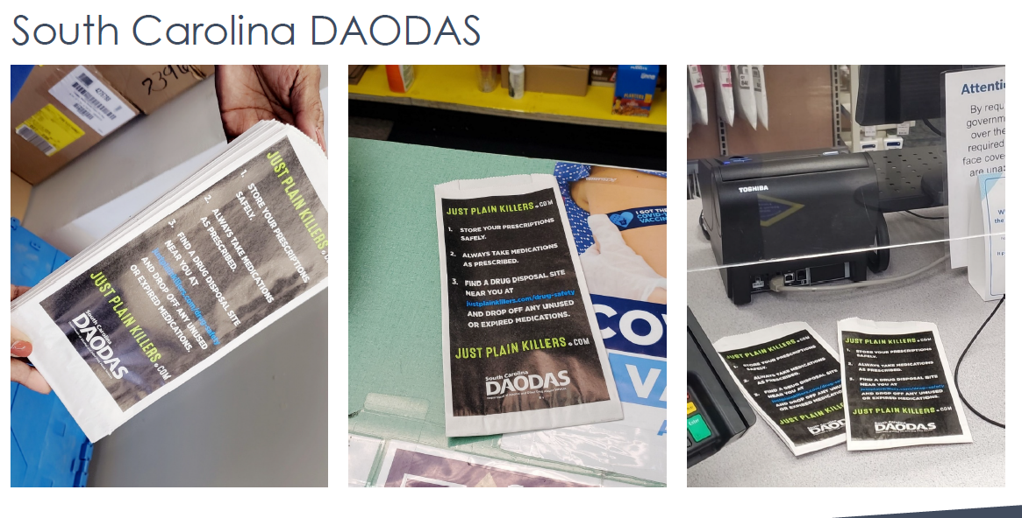

Slide 31
1801 Main Street, 4th Floor • Columbia, South Carolina 29201
telephone: 803-896-5555 • fax: 803-896-5558
www.daodas.sc.gov
Notes:
Final Slide

